Slide 1

DESIGN, CONSTRUCTION AND PERFORMANCE TESTING OF A LANDSCAPE IRRIGATION RUNOFF MITIGATION SYSTEM
Junfeng Men
Advisor: Dr. Jorge Alvarado
Committee Member: Dr. Michael Pate
Dr. Benjamin Wherley

Slide 2
Outline
Introduction & Motivation
Literature Review
Design And Fabrication of Landscape Irrigation Runoff Mitigation System (LIRMS)
Results & Discussion
Conclusion
Future Work

Slide 3
Introduction & Motivation

Slide 4
Introduction & Motivation
Water planning becomes necessary and significant in nowadays Texas
Runoff waste represents up to 1/3 of the typical amount of water of irrigation if cycle-soaking is not applied correctly
Few products have the concept of detecting runoff to realize complete cycle-soaking
Existing products have limitations in terms of working performance

Slide 5
Literature Review

Slide 6
Current Circumstances and Effects of the Urban Runoff
Weibel et al. “Urban Land Runoff as a Factor in Stream Pollution.” (1963)
Investigated the role of urban land runoff in stream pollution
Sample area included family homes, stores, restaurants and other public buildings
The study showed the storm runoff can cause a rise of various elements which could be treated as the indexes of pollution

Slide 7
Current Circumstances and Effects of the Urban Runoff
Gromaire-Mertz et al. “Characterization of Urban Runoff Pollution in Paris.” (1999)
Confirmed the urban runoff has projected a big threat to water quality
Found the heavy metal concentrations in the runoff have greatly exceeded water quality standards
Robert A. Kimbrough et al. “Pesticides in Streams Draining Agricultural and Urban Areas in Colorado.” (1996)
Detected pesticides in both agricultural runoff and urban runoff
Concluded that both agricultural and urban runoffs contribute to the spread of pesticides in streams

Slide 8
Current Circumstances and Effects of the Urban Runoff
Weston et al. “Residential Runoff as a Source of Pyrethroid Pesticides to Urban Creeks.” (2009)
Focused on the pyrethroid pesticides carried by the residential runoff to urban creeks
Storm runoff is indicated the most significant cause of transporting pyrethroid pesticides to local creeks
Hoffman et al. “Urban Runoff as a Source of Polycyclic Aromatic Hydrocarbons to Coastal Waters.” (1984)
Considered urban runoff as a factor of growing polycyclic aromatic hydrocarbons (PAHs) in coastal areas
Concluded that the urban runoff should be responsible for 71% of the total higher molecular weight PAHs and 36% of the total PAHs

Slide 9
Potential and Commercial Products for the Irrigation Process
Bernard Cardenas-Lailhacar et al. “Expanding Disk Rain Sensor Performance and Potential Irrigation Water Savings.” (2008)
Developed experiments concentrating on the performance of expanding disk rain sensor
Wireless rain-click rain sensor can save up to 44% water, while mini-click rain sensor can save 3% - 30% water
McCready et al. “Water Conservation Potential of Smart Irrigation Controllers on St. Augustinegrass.” (2009)
Rain sensor can reduce the irrigation water consumption by 7% - 30%
SMS sensor (Soil Moisture Sensor Controllers) can reduce the irrigation water consumption by up to 74%
ET sensor (Evapotranspiration Based Controllers) can reduce the irrigation water consumption by 25% - 62%

Slide 10
Design And Fabrication of Landscape Irrigation Runoff Mitigation System

Slide 11
Objectives
The objective of the current study was to design a reliable, durable and low-cost LIRMS.
The LIRMS needs to intelligently control irrigation (cycled-soaking) to reduce runoff and save water
The LIRMS needs to be reliable in all environmental circumstances and strong enough to endure impact or mechanical failure
The LIRMS needs to be low-cost for mass production
The LIRMS should be capable of working alone as well as acting as an add-on in an existing irrigation system
An energy-saving version of LIRMS is desired

Slide 12
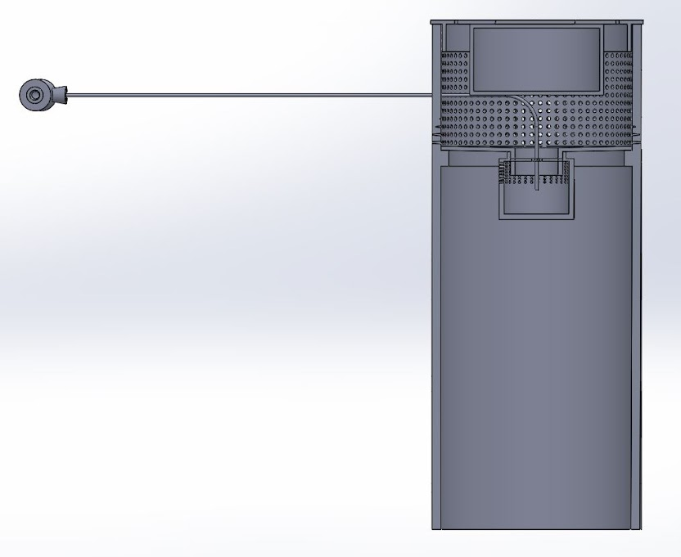
Conceptualized Designs: Eductor Prototype
Eductor
The runoff will be collected in a chamber
The eductor should extract water out when the water reaches a certain level
The runoff should be detected by using an instrument downstream from the device
Inlet
Electronic Box
Waterline
Runoff Chamber

Slide 13
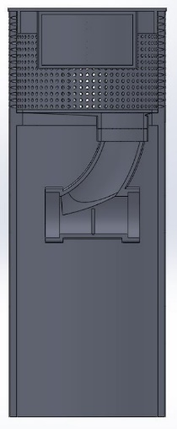
Conceptualized Designs: Infrared Prototype
A glass lens is set at the middle of the bottom cylindrical tube
A reflective angle will be detected by the infrared sensor when runoff runs through
Inlet
Electronic Box
Infrared Sensor
Exit
Glass Lens

Slide 14
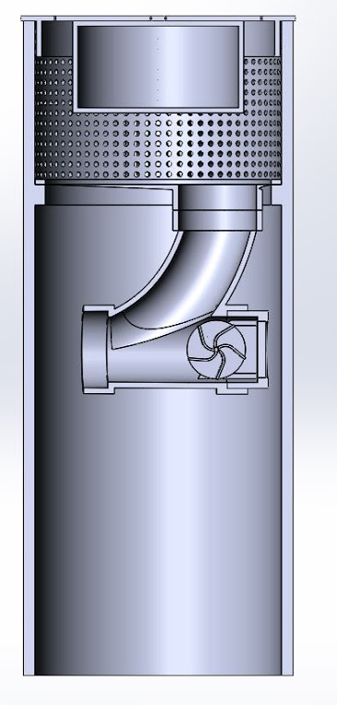
Conceptualized Designs: Paddle Wheel Prototype
Paddle wheel at the downstream location will be activated by runoff
A hall effect sensor might be needed to detect the rotation of the paddle wheel
The prototype should measure the amount of runoff that runs through it
Inlet
Electronic Box
Exit
Paddle Wheel

Slide 15
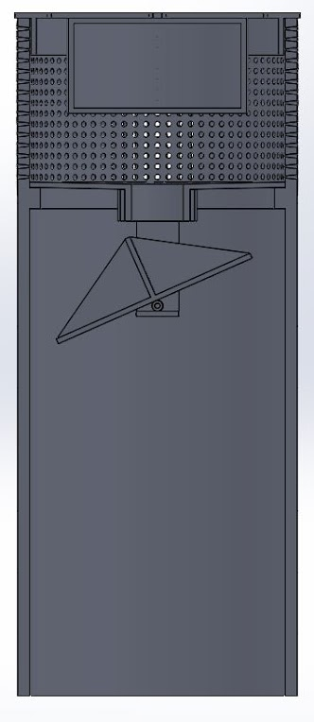
Conceptualized Designs: Tip Bucket Prototype
The bucket will tip due to the collection of the runoff
A switch or infrared sensor might be needed to detect the tips of the bucket
Inlet
Tip Bucket
Exit

Slide 16
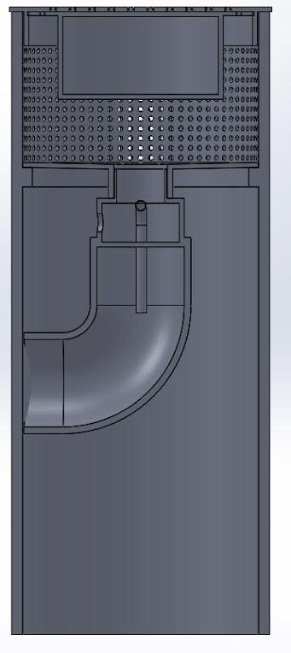
Conceptualized Designs: Float Prototype
Runoff enters the prototype and is accumulated in the runoff compartment
A float sensor is installed at the top of the compartment
The float switch will be activated when water level in the compartment reaches a set threshold
Inlet
Exit
Float Sensor
Runoff Compartment

Slide 17
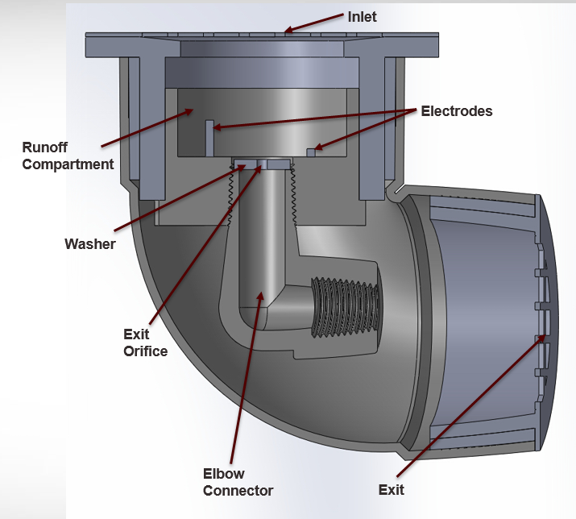
Conceptualized Designs: Conductivity Prototype
Inlet
Runoff enters the prototype and is accumulated in the runoff compartment
One electrode is installed at the bottom of the compartment while the other one is installed at a set height above the bottom electrode
Water will act as a conductive medium, making the conductivity prototype an ON/OFF switch
Runoff Compartment
Exit

Slide 18
Comparison between Designs
Device Type | Advantages | Disadvantages | Constructed? | Comments
Eductor Prototype | 1. Sensitive 2. Reliable 3. No moving parts | 1. Need high efficiency filter system to avoid clogging issue 2. Hard to install 3. Need power input | No | Based on the working principle of the eductor prototype, the waterline should have a very small diameter, which could get clogged very easily. Also, it needs an extra power input, which requires more energy. Thus this idea has not been adopted.
Infrared Prototype | 1. Do not need drain line 2. Reliable 3. Do not need much maintenance | 1. High cost 2. Complex program | No | The high cost and complex program make this prototype not suitable for a low-cost and user-friendly runoff sensor. Thus this idea has not been adopted.

Slide 19
Comparison between Designs (Con)
Comparison between Designs (contd.)
Device Type | Advantages | Disadvantages | Constructed? | Comments
Paddle Wheel Prototype | 1. Could measure the amount of runoff that runs through the sensor | 1. Has moving parts 2. Clogging issue 3. Debris may affect the motion of the paddle | Yes | Despite the disadvantages mentioned, its greatest feature is its ability to measure runoff on a continuous basis, which is direct and useful for performance evaluation and irrigation control. Thus this prototype has been constructed.
Tip Bucket Prototype | 1. Could measure the amount of runoff that runs through the sensor 2. Do not need much maintenance | 1. Has moving parts 2. Clogging issue 3. Debris may accumulate in the buckets and affect the motion of it | No | The tip bucket prototype has a very similar working principle and mechanism as the paddle wheel prototype. Since the paddle wheel prototype has been constructed, the tip bucket prototype has not been adopted.

Slide 20
Comparison between Designs (Con)
Comparison between Designs (contd.)
Device Type | Advantages | Disadvantages | Constructed? | Comments
Float Prototype | 1. Simple 2. Reliable 3. No moving parts | 1. Need high efficiency filter system to avoid clogging issue 2. Lag in response time | Yes | The float prototype is simple and easy to build, plus it is reliable and inexpensive. Though it exhibits a lagging response, it has been constructed and adopted.
Conductivity Prototype | 1. Easy to build 2. Heavy-built 3. No moving parts | 1. Need high efficiency filter system to avoid clogging issue 2. Lag in response time 3. Rust on electrodes | Yes | The conductivity prototype is reliable and inexpensive. It can endure great impact and could also be constructed quickly. Though it exhibits a lagging response, it has been constructed and adopted.

Slide 21
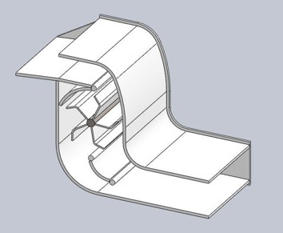
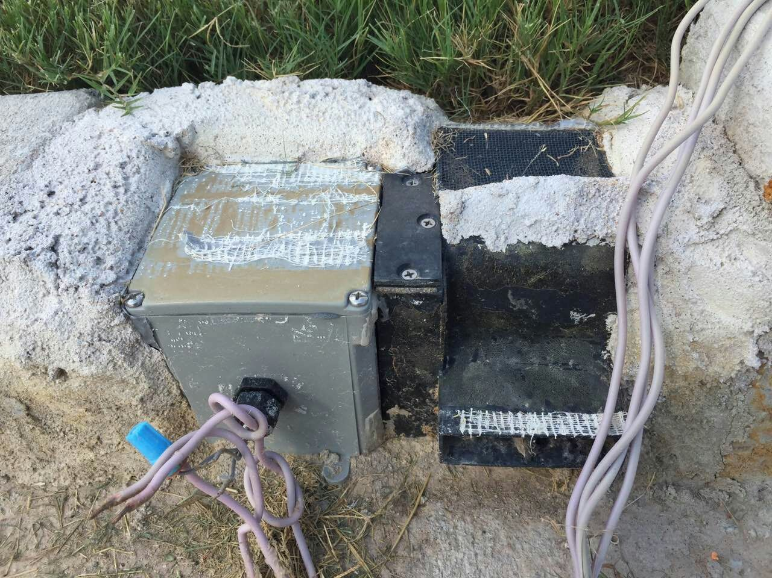
Final Designs: Paddle Wheel Prototype
Inlet
Redesigned to accommodate electronic system
The water receiving end was modified so water did not have to go through the entire system
The mechanical system was separated from the electronic side by using a shaft/coupling
Exit
Paddle Wheel

Slide 22
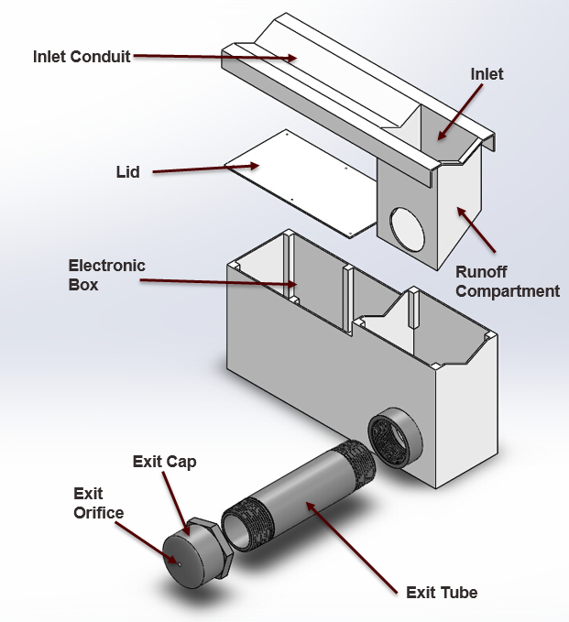
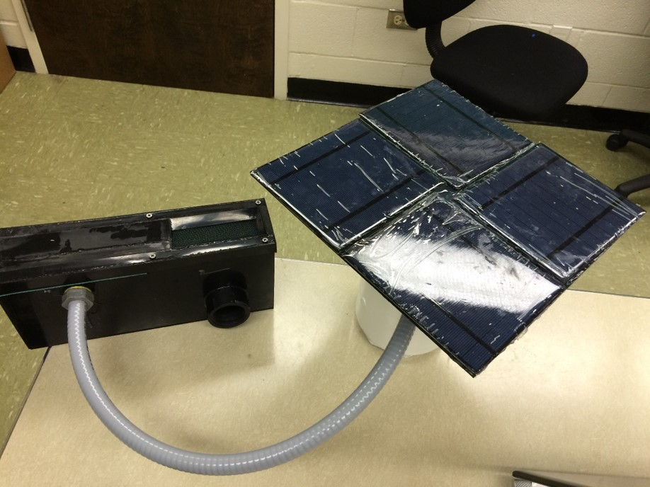
Final Designs: Cubic Float Prototype
Redesigned to be equipped with an electronic box for the controller
The shape has been redesigned to accommodate an inlet conduit for higher efficiency of gathering runoff

Slide 23
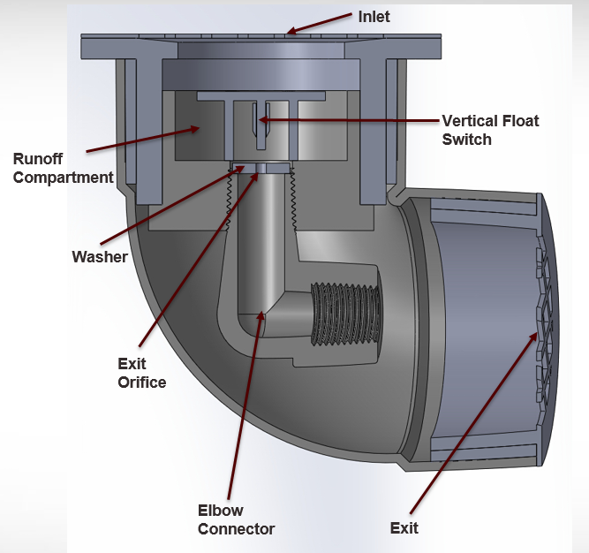
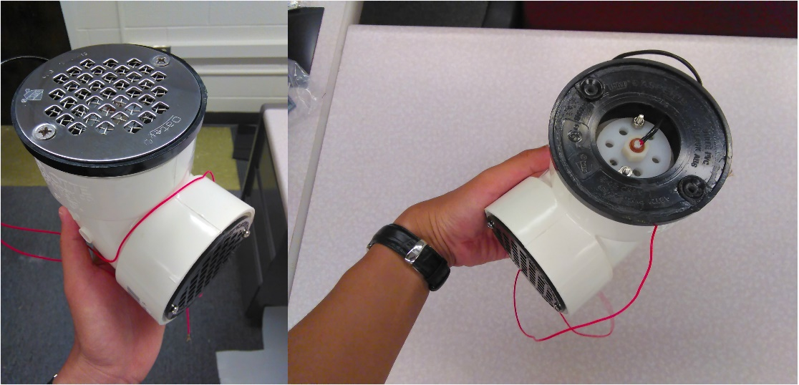
Final Designs: Elbow Float Prototype
Used the same outer shell as the conductivity prototype
The new layout accommodated a vertical float sensor

Slide 24
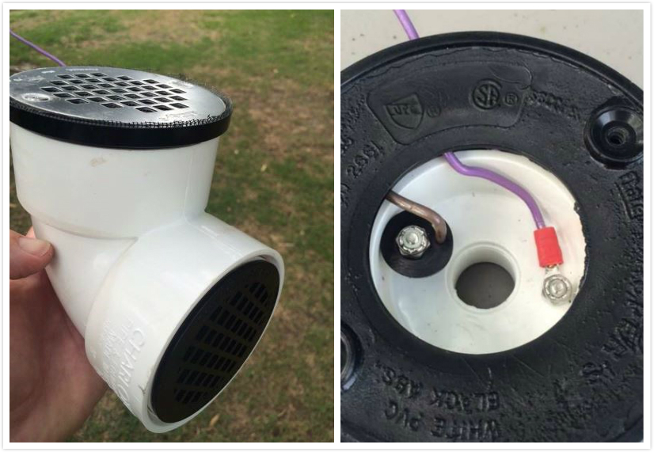
Final Designs: Conductivity Prototype
The conductivity prototype has kept its original design configuration

Slide 25
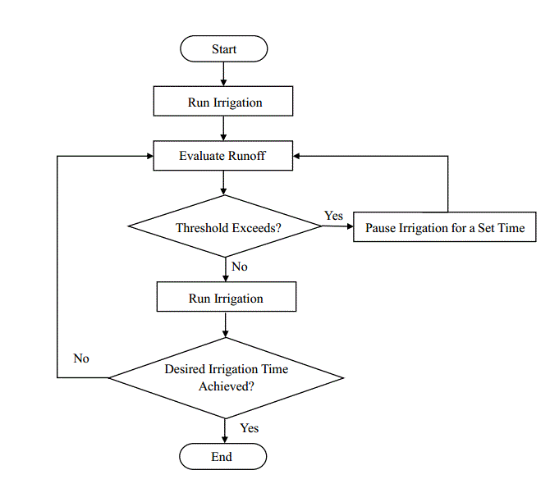
Operating Principle of the I/O Communication and Control Module

Slide 26
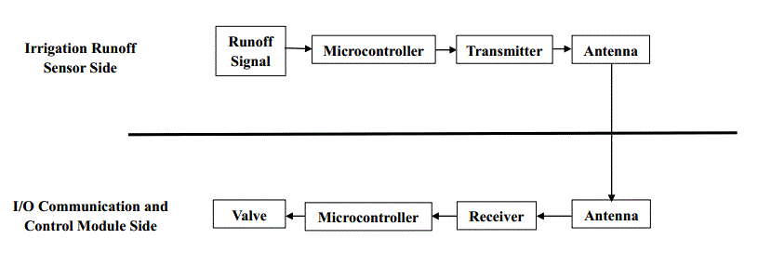
1st Generation of the I/O Communication and Control Module: Arduino Phase
The transmitter board (the upper part) is installed on the irrigation runoff sensor side
The receiver board (the lower part) is on the I/O communication and control side
Runoff signals will be transferred by the wireless communication established by the transmitter/receiver

Slide 27
EAGLE Drawing of the Transmitter PCB
A Fabricated Transmitter PCB

Slide 28
EAGLE Drawing of the Receiver PCB
A Fabricated Receiver PCB

Slide 29
2nd Generation of the I/O Communication and Control Module: Integrated Phase
When runoff occurs, signals are sent to the runoff signal input on the PCB
The microcontroller open/close the relay based on the signals to control the irrigation cycle
The irrigation data are stored in the Secure Digital (SD) Card

Slide 30
Comparison Between the Two Generations
 | Voltage (V) | Current (A) | Power (W) | Number of PCB Needed | Weekly Working Time (h) | Weekly Energy Consumption (Watt-Hour)
1st Generation | 5 | 0.05 | 0.25 | 9 | 168 | 42
2nd Generation | 9 | 1 | 9 | 1 | 1 | 9
Compared to the 1st generation, the 2nd generation of the I/O communication and control module:
is low cost and could hardly be affected by the surroundings or environmental noise;
results 78.6% in energy savings

Slide 31
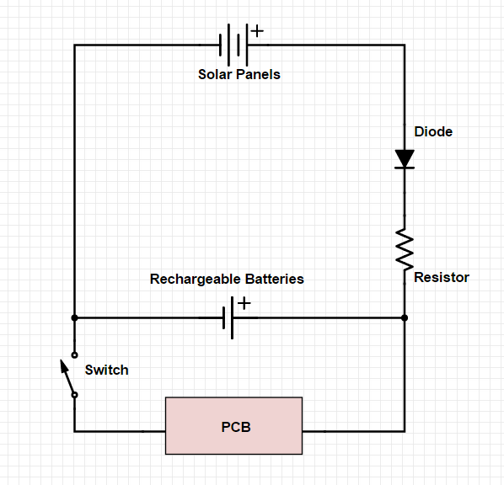
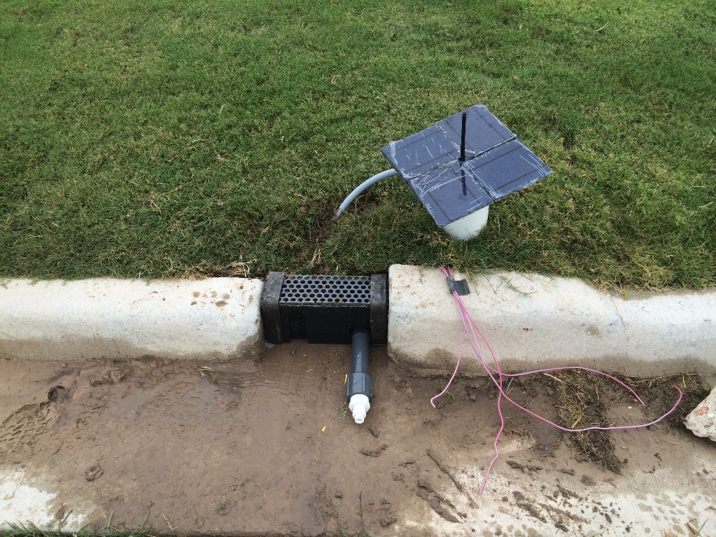
Autonomous Power Supply Module
An autonomous power supply module consisting of solar panels and rechargeable batteries has been designed
During daytime, the solar panels of the autonomous power supply module provides the energy for the PCB while recharging the batteries
During times without sunlight, the rechargeable batteries provide the PCB with the energy

Slide 32
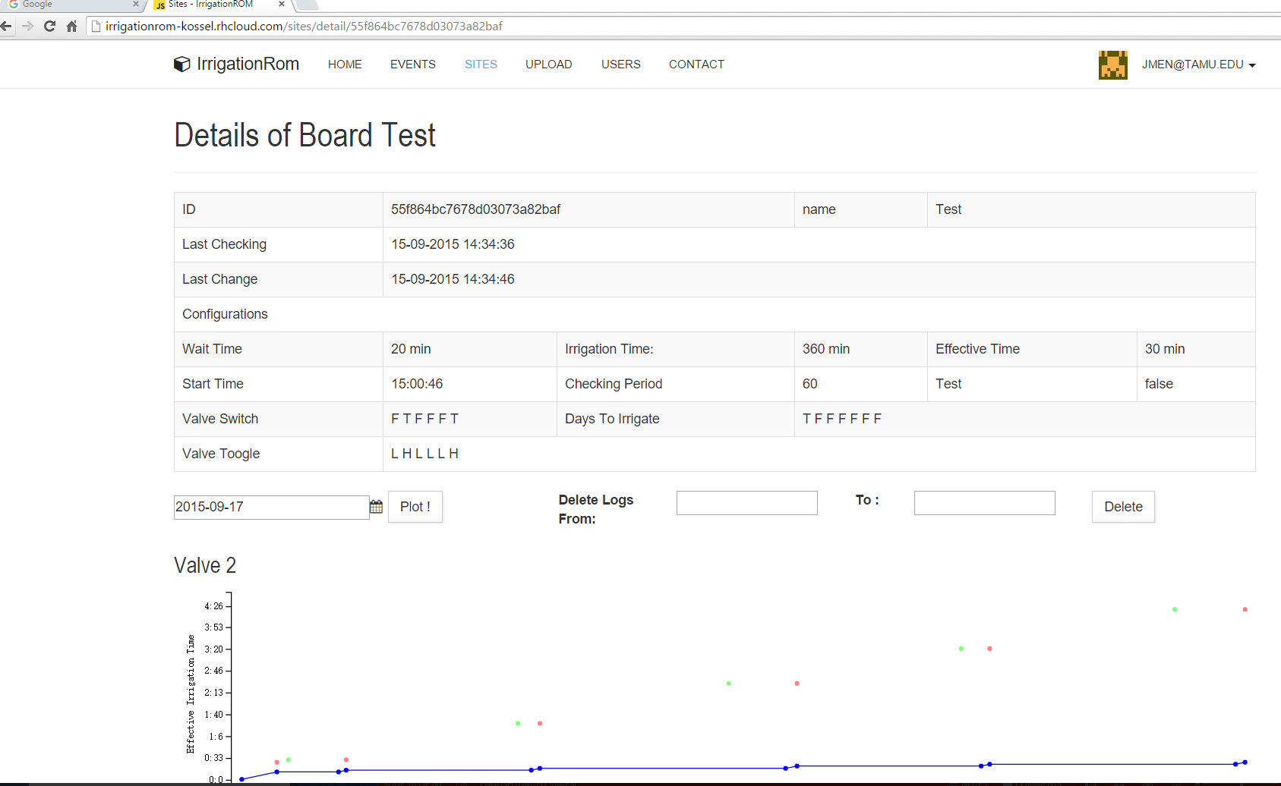
Irrigation Results Analysis Website Design
An irrigation results analysis website (http://irrigationrom-kossel.rhcloud.com/) has been designed to:
store the irrigation data in the web server;
plot the irrigation result charts as needed.

Slide 33
Results & Discussion

Slide 34
Terminology
Effective Irrigation Time (EIT): The total amount of time that the sprinkler is on during an irrigation event.
Wait Time (WT): A manually set value of the pause time of the irrigation system when runoff is detected.
Start Time (ST): The time of the day when the irrigation is set to begin.
Real Irrigation Time (RIT): The total time that the whole the system is in operation.
Total Irrigation Time (TIT): A maximum limit which should not be exceeded. When EIT is reached or RIT ⩾ TIT, the irrigation event is finished.

Slide 35
Terminology in a Typical Irrigation Results Chart
Real Irrigation Time (RIT)

Slide 36
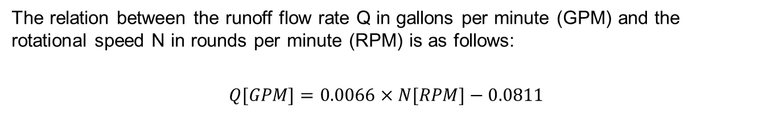
Lab Testing Results for the Paddle Wheel Prototype
The relation between the runoff flow rate Q in gallons per minute (GPM) and the rotational speed N in rounds per minute (RPM) is as follows:
$Q[GPM]=0.0066×N[RPM]−0.0811$

Slide 37
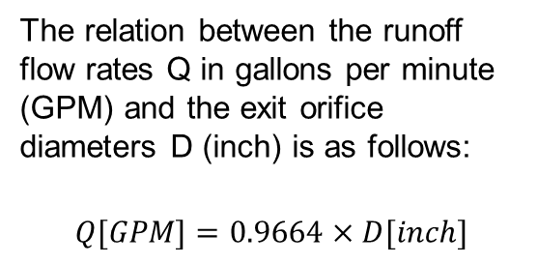
Lab Testing Results for the Cubic Float Prototype
Exit Orifice Diameter (inch) | Runoff Flow Rate (GPM)
0.25 | 0.296
0.1875 | 0.156
0.125 | 0.071
0.0625 | 0.018
The relation between the runoff flow rates Q in gallons per minute (GPM) and the exit orifice diameters D (inch) is as follows:
$$Q[GPM]=0.9664×D[inch]$$

Slide 38
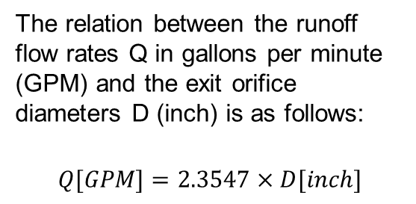
Lab Testing Results for the Elbow Float Prototype
Exit Orifice Diameter (inch) | Runoff Flow Rate (GPM)
0.5 | 1.183
0.25 | 0.598
0.125 | 0.253
The relation between the runoff flow rates Q in gallons per minute (GPM) and the exit orifice diameters D (inch) is as follows:
$$Q[GPM]=2.3547×D[inch]$$

Slide 39
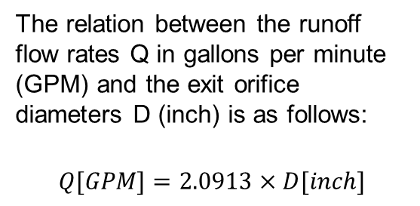
Lab Testing Results for the Conductivity Prototype
Exit Orifice Diameter (inch) | Runoff Flow Rate (GPM)
0.125 | 0.22
0.6875 | 1.4
0.75 | 1.61
The relation between the runoff flow rates Q in gallons per minute (GPM) and the exit orifice diameters D (inch) is as follows:
$$Q[GPM]=2.0913×D[inch]$$

Slide 40
Comparison of Working Ranges of Different Prototypes
Prototype | Working Range (GPM)
Paddle Wheel Prototype | 0.08 - 1.78
Cubic Float Prototype | 0.01 - 0.3
Elbow Float Prototype | 0.05 - 1.4
Conductivity Prototype | 0.05 - 1.7
The paddle wheel prototype and the conductivity prototype have the greatest range
The cubic float prototype has a narrower range of operation, which makes the device more sensitive to runoff
The last three prototypes can detect small flow rate when a small exit orifice hole is used
However, small orifices are more prone to clogging and may require regular cleaning

Slide 41
Qualitative Field Testing Results
Irrigation Configurations for July 14th
Start Time | 8:00 AM
Effective Irrigation Time | 1.5 hour
Wait Time | 20 minutes
# of Tested Valve | 2 (Conductivity Prototype), 4 (Cubic Float Prototype), 5 (Cubic Float Prototype), 6 (Conductivity Prototype), 7 (Control), 9 (Elbow Float Prototype)

Slide 42
Plot 2 (Conductivity Prototype) Result Charts for July 14th 2015

Slide 43
Plot 5 (Cubic Float Prototype) Result Charts for July 14th 2015

Slide 44
Plot 7 (Control) Result Charts for July 14th 2015

Slide 45
Plot 9 (Elbow Float Prototype) Result Charts for July 14th 2015

Slide 46
Comparison of the Performance during Qualitative Field Testing
Prototype | Plot # | Times of Being Tested | Times of Successful Tests | Success Rate (Successful test/Total number of tests) | Longest Working Time without Breaking Down | Comments
Paddle Wheel Prototype | 1 | N/A | N/A | N/A | N/A | The paddle wheel prototypes have encountered various problems preventing them from working properly. Plot 1 never worked while plot 3 kept having clogging issues and water-damage.
 | 3 | 1 | 0 | 0 | N/A
Cubic Float Prototype | 4 | 9 | 9 | 100% | 15 Weeks | The cubic float prototypes could work for a long time without maintenance. During the 4-month testing period, no problem has been detected.
 | 5 | 9 | 9 | 100% | 16 Weeks

Slide 47
Comparison of the Performance during Qualitative Field Testing (contd.)
Prototype | Plot # | Times of Being Tested | Times of Successful Tests | Success Rate (Successful test/Total number of tests) | Longest Working Time without Breaking Down | Comments
Elbow Float Prototype | 9 | 4 | 3 | 75% | 3 Weeks | The elbow float prototype has had a problem of clogging and thus needed a maintenance biweekly. The vertical float sensor finally broke down after 3 weeks.
Conductivity Prototype | 2 | 9 | 7 | 77.8% | 8 Weeks | The conductivity prototypes have had problems of rusting and clogging, which needed biweekly maintenance. The conductivity prototypes have also shown the capability of working reliably and properly for a long time with appropriate maintenance.
 | 6 | 9 | 9 | 100% | 16 Weeks

Slide 48
Quantitative Field Testing Results
Irrigation Configurations for Sept 21st
Start Time | 7:20 AM
Effective Irrigation Time | 30 minutes
Wait Time | 10 minutes
# of Tested Valve | 15 (Conductivity Prototype), 18 (Control)

Slide 49
Effective Irrigation Time Charts for Sept 21st
Plot 15 (Conductivity)

Slide 50
Runoff Flow Rate Charts for Sept 21st
Plot 15 (Conductivity)
Plot 18 (Control)
Change to a Lower Scale

Slide 51
Summary of the Results for Sept 21st
 | Irrigation Time, IT (hr:min:sec) | Total Amount of Used Water (Gallon) | Runoff (Gallon) | Water Absorbed by Soil (Gallon) | Water Absorption Rate (Water Absorbed/Total Use) | % of Runoff Reduction
Plot 15 (Conductivity Prototype) | 5:30:53 | 237 | 51.55 | 185.45 | 78.2% | 41.51%
Plot 18 (Control) | 0:30:02 | 231 | 88.13 | 142.87 | 61.8%

Slide 52
Quantitative Field Testing Results
Irrigation Configurations for Sept 25th
Start Time | 6:00 AM
Effective Irrigation Time | 30 minutes
Wait Time | 10 minutes
# of Tested Valve | 15 (Cubic Float Prototype), 18 (Control)

Slide 53
Effective Irrigation Time Charts for Sept 25th
Plot 15 (Cubic Float)

Slide 54
Runoff Flow Rate Charts for Sept 25th
Plot 15 (Cubic Float)
Plot 18 (Control)
Change to a Lower Scale

Slide 55
Summary of the Results for Sept 25th
 | Irrigation Time, IT (hr:min:sec) | Total Amount of Used Water (Gallon) | Runoff (Gallon) | Water Absorbed by Soil (Gallon) | Water Absorption Rate (Water Absorbed/Total Use) | % of Runoff Reduction
Plot 15 (Cubic Float Prototype) | 7:41:02 | 241 | 49.8 | 191.2 | 79.3% | 39.83%
Plot 18 (Control) | 0:30:01 | 223 | 82.77 | 140.23 | 62.9%

Slide 56
Key Observations
Conductivity Prototype has only 51.55 gallons of runoff, leading to a runoff reduction rate of 41.51%
Conductivity prototype has allowed 5:30:53 for the 30-minutes effective irrigation, which prevents the nutrients from being flushed by the runoff
Cubic float prototype has reduced the runoff by 39.83%, a little lower than the conductivity prototype
However, the cubic float prototype has allowed 7:41:02 for the 30-minutes effective irrigation, two hours longer than the conductivity prototype
Electronic system is an integral part of any water saving (irrigation) system

Slide 57
Conclusion

Slide 58
Conclusion
The performance of conductivity and the cubic float prototype was validated both in the lab and in the field to show the capability of detecting runoff
The I/O Communication and Control Module is able to control cycled-soaking processes effectively
The conductivity prototype resulted in 40% - 50% reduction in runoff based on a 30 minutes effective irrigation

Slide 59
Conclusion (contd.)
The cubic float prototype showed the ability of reducing runoff by 40% and allowed greater water absorption
A web-based interface (i.e. server) was designed and programmer so that irrigation data could be accessed online
A wireless communication module and an autonomous energy system were designed and tested to allow wireless communication between the irrigation runoff sensors and the control unit which also allowed for energy savings

Slide 60
Future Work: Reduction of Effective Irrigation Time
Further studies should focus on investigating different irrigation strategies for runoff reduction, grass quality and economic benefits.
Reduction of Effective Irrigation Time
The effective irrigation time of the experimental plot could be reduced in order to maintain the same quality of the grass as the control plot by reducing the level of water absorption for the same weekly irrigation frequencies.
 | Experimental Group | Control Group
Effective Irrigation Time | EIT < 30 minutes | 30 minutes
Weekly Irrigation Frequency (WIF) | 1/Week | 1/Week
Amount of Water Absorbed | Same

Slide 61
Future Work: Reduction of Irrigation Frequency
2. Reduction of Irrigation Frequency
In order to maintain the same quality of grass of the experimental and the control plots, the weekly irrigation frequency of the experimental plot can be reduced while the effective irrigation time of every irrigation event remains the same.
 | Experimental Group | Control Group
Effective Irrigation Time | 30 minutes | 30 minutes
Weekly Irrigation Frequency (WIF) | WIF < 1/Week | 1/Week
Amount of Water Absorbed | Same

Slide 62
Future Work: Self-Adjustable LIRMS for Minimum Runoff
3. Self-adjustable LIRMS for Minimum Runoff
An intelligent controller module with autonomous learning abilities should be considered in the future.
 | Real Irrigation Time | RDT | RET
1st Trial | 30 minutes | 30 minutes | 4 minutes
2nd Trial | 28 minutes | 40 minutes | 2 minutes
3rd Trial | 26 minutes | 45 minutes | 1 minute
Case Scenarios:
Runoff Detection Time (RDT): the time between the start of the irrigation (SI) and the time of runoff .
Runoff Existing Time (RET): the time between detection and disappearance of runoff.
Optimally, the LIRMS system should keep adjusting RDT and RET, with the ultimate goal of maximizing RDT while minimizing RET.

Slide 63

Thanks!
Any Questions?

Slide 64
Back Up Slides

Slide 65
Qualitative Field Testing

Slide 66
Irrigation Results on April 8th 2015
Irrigation Configurations
Start Time | 7 AM
Effective Irrigation Time | 30 minutes
Wait Time | 20 minutes
# of Tested Valve | 5, 6

Slide 67
Plot 5 Result Charts on April 8th 2015

Slide 68
Plot 6 Result Charts on April 8th 2015

Slide 69
Results Analysis on April 8th 2015
Results Analysis
The intervals showed that the cubic float prototypes could detect the runoff and send the signal to the controller.
The controller could close the irrigation when runoff has been detected and resume the irrigation when the set wait time is reached.
The two plots have different effective irrigation time, which might be caused by interferences and noises in the controller board.

Slide 70
Irrigation Results on April 15th 2015
Irrigation Configurations
Start Time | 7:30 AM
Effective Irrigation Time | 30 minites
Wait Time | 20 minutes
# of Tested Valve | 2, 4, 5, 6, 7, 8

Slide 71
Plot 2 Result Charts on April 15th 2015

Slide 72
Plot 4 Result Charts on April 15th 2015

Slide 73
Plot 5 Result Charts on April 15th 2015

Slide 74
Plot 6 Result Charts on April 15th 2015

Slide 75
Plot 7 Result Charts on April 15th 2015

Slide 76
Plot 8 Result Charts on April 15th 2015

Slide 77
Results Analysis on April 15th 2015
Results Analysis
The intervals showed that the cubic float prototypes and the conductivity prototypes could detect the runoff and send the signal to the controller.
The two cubic float prototypes allowed more time for soil to absorbing water than the two conductivity ones.
The intervals at the beginning of plot 2, 4, 5 and 6 and the middle of plot 7 and 8 indicated the interference still exists.

Slide 78
Irrigation Results on June 16th 2015
Irrigation Configurations
Start Time | 8:00 AM
Effective Irrigation Time | 1 hour
Wait Time | 20 minutes
# of Tested Valve | 2, 3, 4, 5, 7, 8

Slide 79
Plot 2 Result Charts on June 16th 2015

Slide 80
Plot 3 Result Charts on June 16th 2015

Slide 81
Plot 4 Result Charts on June 16th 2015

Slide 82
Plot 5 Result Charts on June 16th 2015

Slide 83
Plot 7 Result Charts on June 16th 2015

Slide 84
Plot 8 Result Charts on June 16th 2015

Slide 85
Results Analysis on June 16th 2015
Results Analysis
The conductivity prototype and the paddle wheel prototype have not been triggered. Later research showed that the conductivity prototype had an issue of clogging while the paddle wheel one had water damage.
The two cubic float prototypes detected runoff and stopped for 20 minutes for the absorption of water.
The interference issue has been elimated.

Slide 86
Irrigation Results on June 24th 2015
Irrigation Configurations
Start Time | 8:00 AM
Effective Irrigation Time | 1 hour
Wait Time | 20 minutes
# of Tested Valve | 2, 4, 5, 6, 7, 8

Slide 87
Plot 2 Result Charts on June 24th 2015

Slide 88
Plot 4 Result Charts on June 24th 2015

Slide 89
Plot 5 Result Charts on June 24th 2015

Slide 90
Plot 6 Result Charts on June 24th 2015

Slide 91
Plot 7 Result Charts on June 24th 2015

Slide 92
Plot 8 Result Charts on June 24th 2015

Slide 93
Results Analysis on June 24th 2015
Results Analysis
The intervals showed that the cubic float prototypes and the conductivity prototypes could detect the runoff and send the signal to the controller.
The two cubic float prototypes allowed more time for soil to absorbing water than the two conductivity ones.
Plot 5 and 6 seemed to have some relevance, may caused by another interference.

Slide 94
Irrigation Results on June 30th 2015
Irrigation Configurations
Start Time | 8:00 AM
Effective Irrigation Time | 1 hour
Wait Time | 20 minutes
# of Tested Valve | 2, 4, 5, 6, 7, 8

Slide 95
Plot 2 Result Charts on June 30th 2015

Slide 96
Plot 4 Result Charts on June 30th 2015

Slide 97
Plot 5 Result Charts on June 30th 2015

Slide 98
Plot 6 Result Charts on June 30th 2015

Slide 99
Plot 7 Result Charts on June 30th 2015

Slide 100
Plot 8 Result Charts on June 30th 2015

Slide 101
Results Analysis on June 30th 2015
Results Analysis
The two cubic float prototypes allowed more time for soil to absorbing water than the two conductivity ones.
Plot 5 and 6 seemed to have some relevance, may caused by another interference. However, they detected runoff at different time, thus the relevance could also probably caused by the field and soil itself.

Slide 102
Irrigation Results on July 11th 2015
Irrigation Configurations
Start Time | 8:00 AM
Effective Irrigation Time | 1 hour
Wait Time | 20 minutes
# of Tested Valve | 2, 4, 5, 6, 7, 9

Slide 103
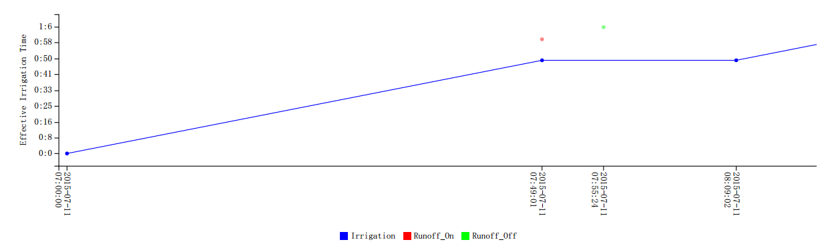
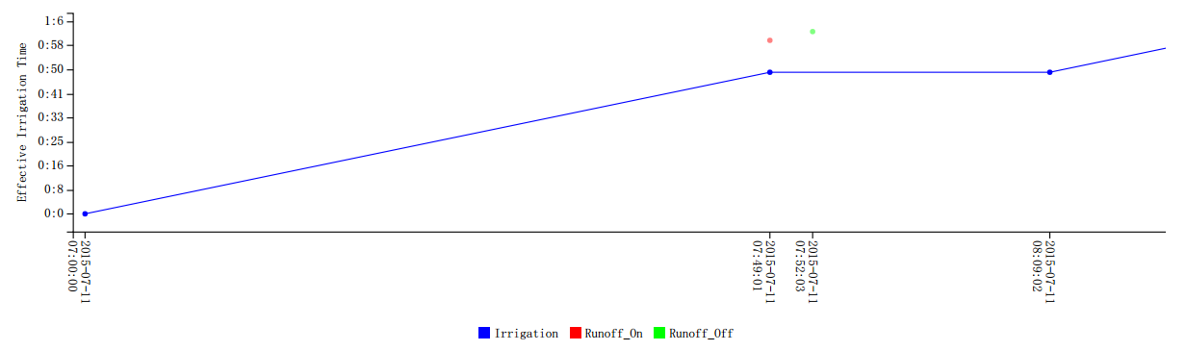
Plot 2, 4 Result Charts on July 11th 2015
Plot 2
Plot 4

Slide 104
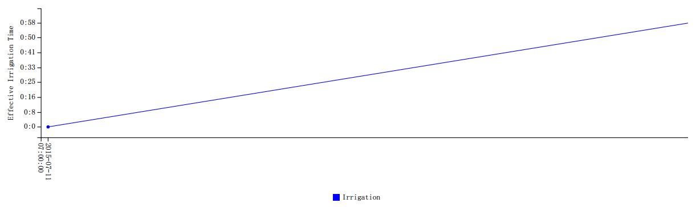
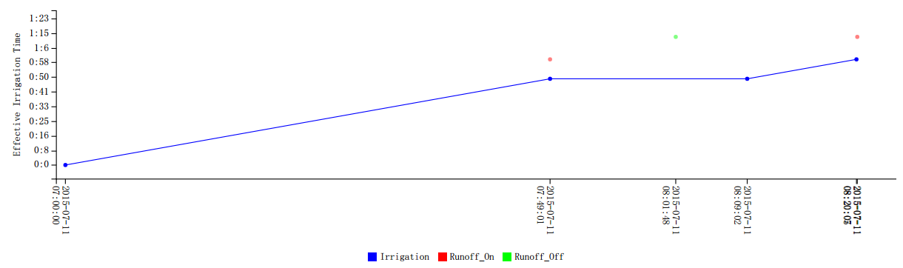
Plot 5, 6 Result Charts on July 11th 2015
Plot 5
Plot 6

Slide 105
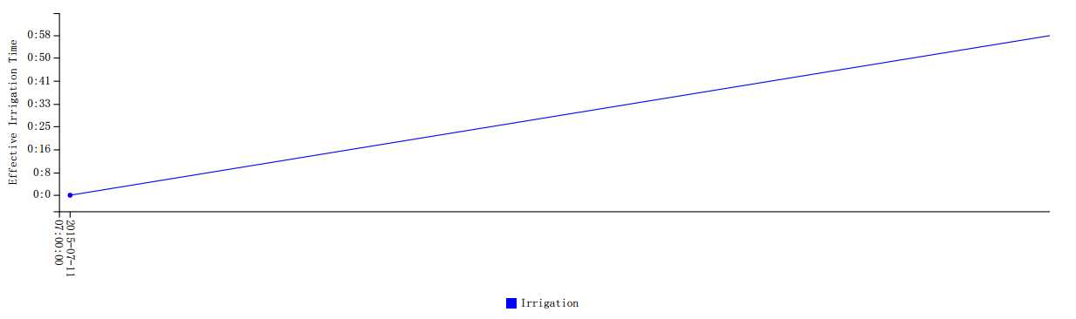
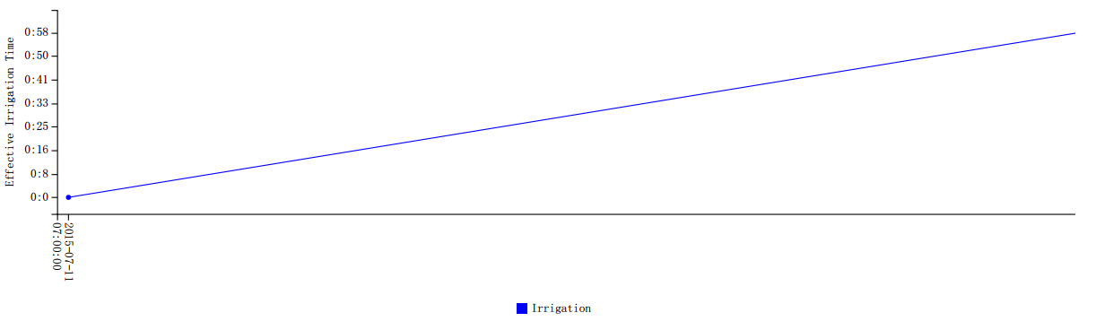
Plot 7, 9 Result Charts on July 11th 2015
Plot 7
Plot 9

Slide 106
Results Analysis on July 11th 2015
Results Analysis
The relevance problem between plot 5 and 6 has disappeared.
Weather was too dry that some plots had no runoff while others detected runoff near the end of the irrigation event.

Slide 107
Irrigation Results on July 14th 2015
Irrigation Configurations
Start Time | 8:00 AM
Effective Irrigation Time | 1.5 hour
Wait Time | 20 minutes
# of Tested Valve | 2, 4, 5, 6, 7, 9

Slide 108
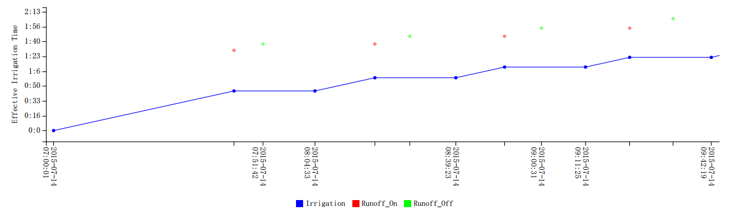
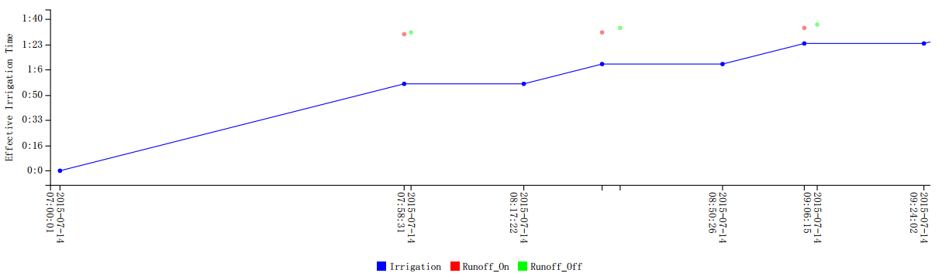
Plot 2, 4 Result Charts on July 14th 2015
Plot 2
Plot 4

Slide 109
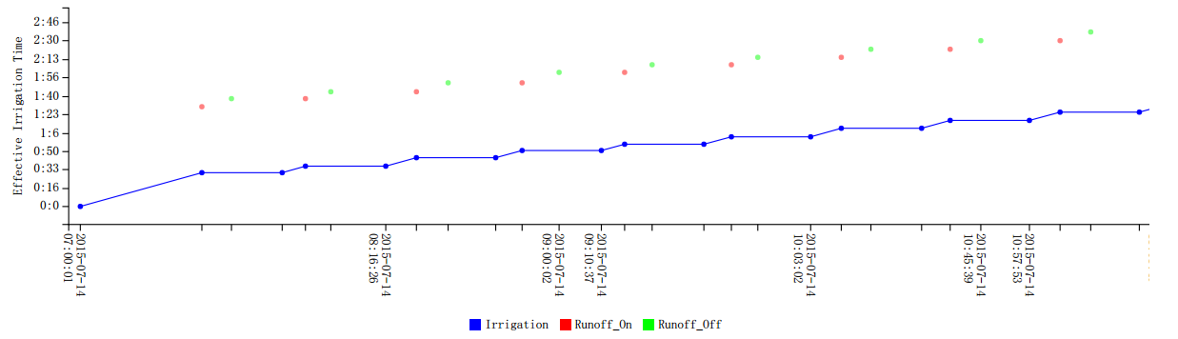
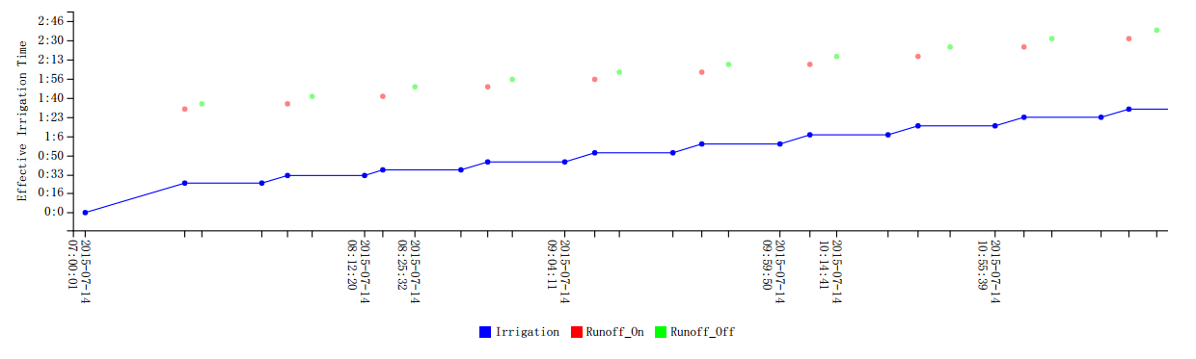
Plot 5, 6 Result Charts on July 14th 2015
Plot 5
Plot 6

Slide 110
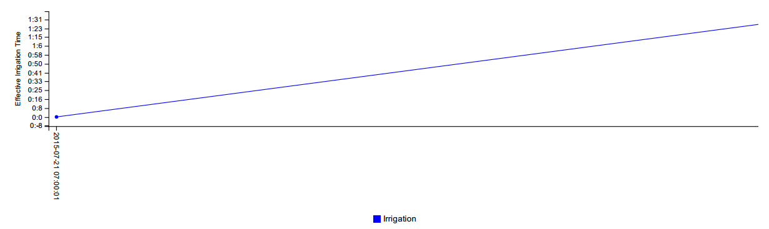
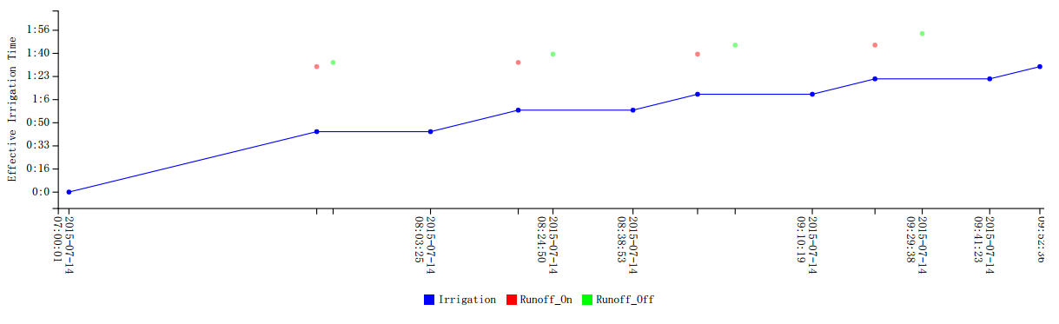
Plot 7, 9 Result Charts on July 14th 2015
Plot 7
Plot 9

Slide 111
Results Analysis on July 14th 2015
Results Analysis
The elbow float prototype could detect runoff and send signals to the controller.
The two cubic float prototypes allowed more time for soil to absorbing water than the elbow float prototype, while conductivity ones allowed the least of time for absorption.
No signal of interference and noise.

Slide 112
Irrigation Results on July 21st 2015
Irrigation Configurations
Start Time | 8:00 AM
Effective Irrigation Time | 1.5 hour
Wait Time | 20 minutes
# of Tested Valve | 2, 4, 5, 6, 7, 9

Slide 113
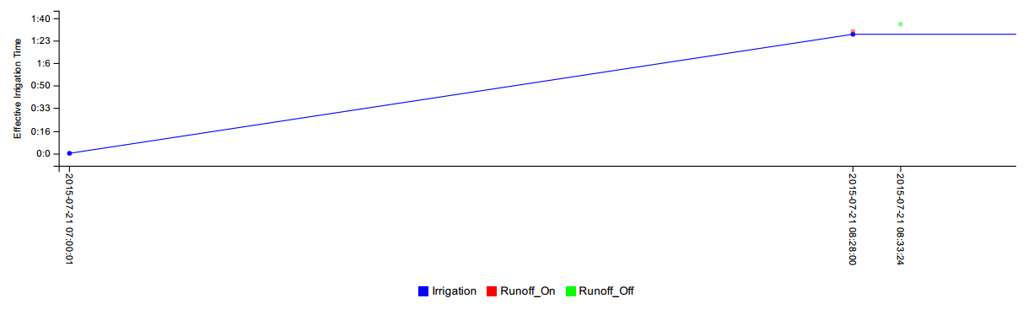
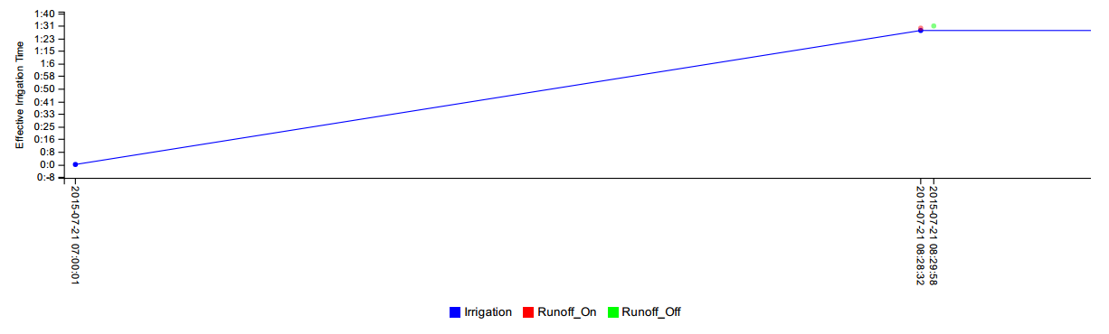
Plot 2, 4 Result Charts on July 21st 2015
Plot 2
Plot 4

Slide 114
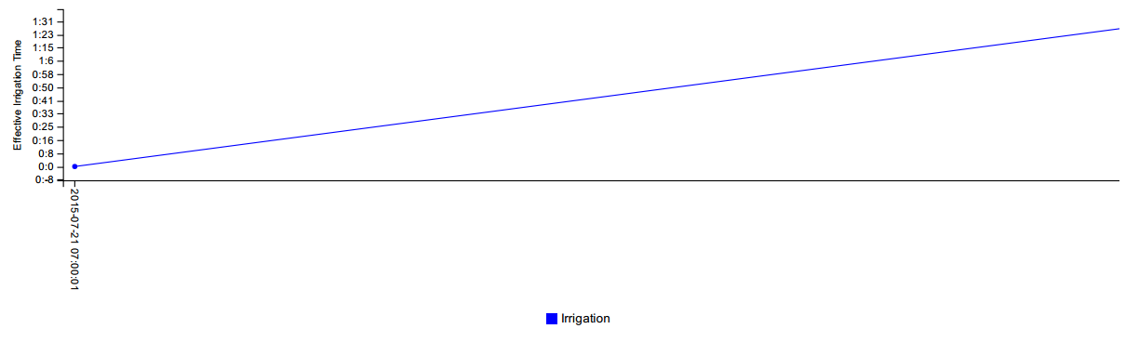
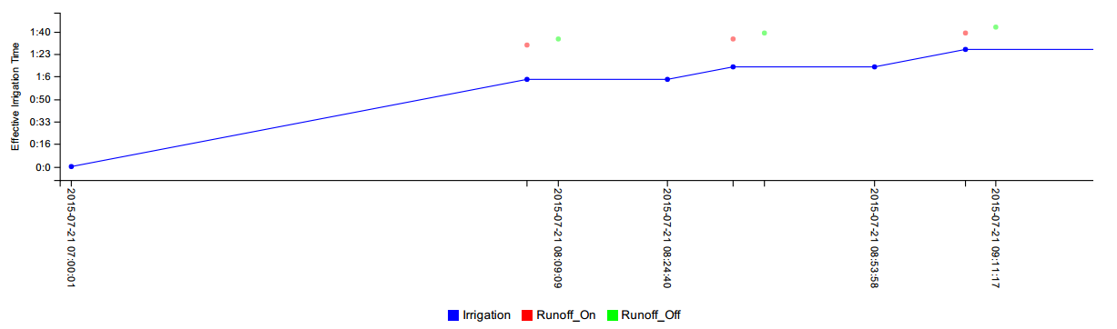
Plot 5, 6 Result Charts on July 21st 2015
Plot 5
Plot 6

Slide 115
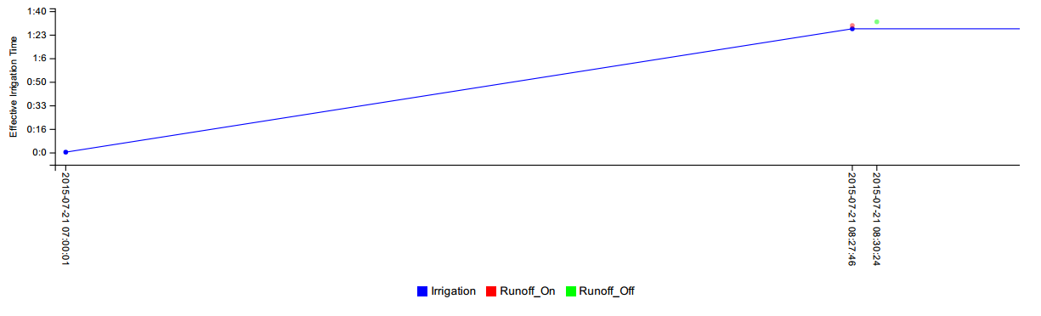
Plot 7, 9 Result Charts on July 21st 2015
Plot 7
Plot 9

Slide 116
Results Analysis on July 21st 2015
Results Analysis
Weather was too dry that some prototypes have not been trigged.
Plot 6 (Conductivity Prototype) allowed the longest time for absorption.

Slide 117
Irrigation Results on Aug 4th 2015
Irrigation Configurations
Start Time | 8:00 AM
Effective Irrigation Time | 1.5 hour
Wait Time | 20 minutes
# of Tested Valve | 2, 4, 5, 6, 7, 9

Slide 118
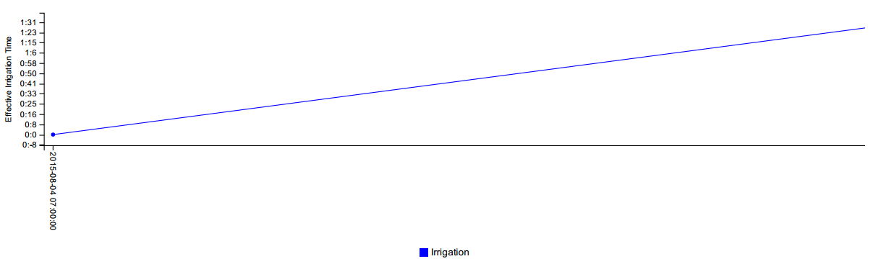
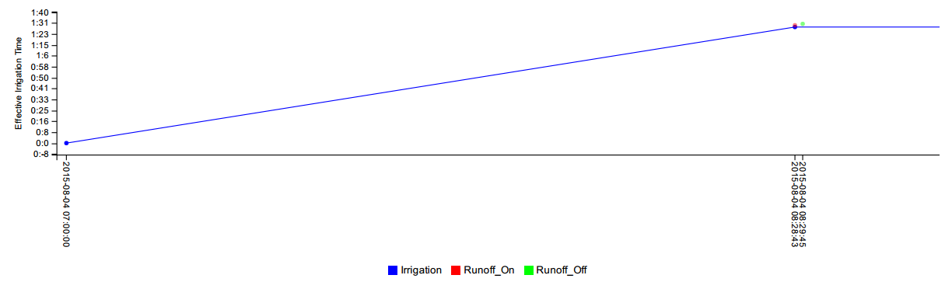
Plot 2, 4 Result Charts on Aug 4th 2015
Plot 2
Plot 4

Slide 119
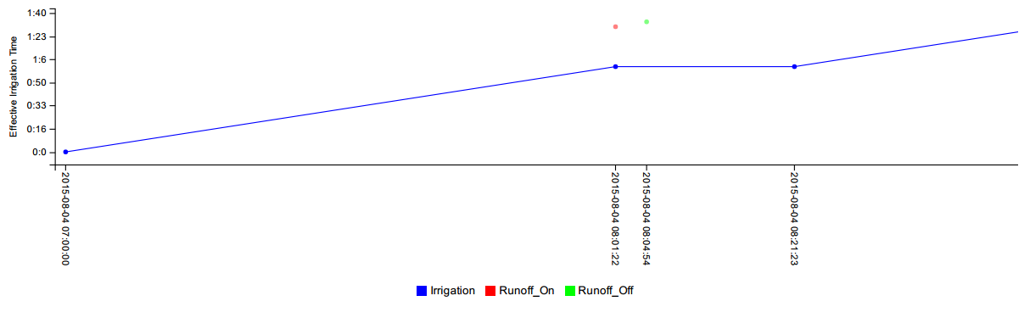
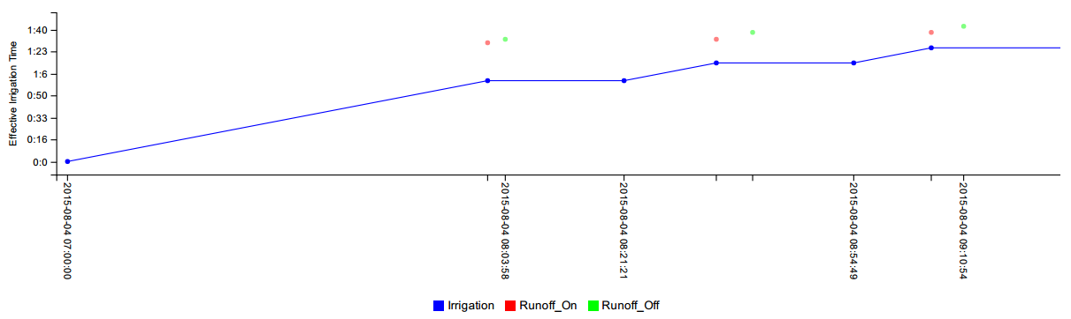
Plot 5, 6 Result Charts on Aug 4th 2015
Plot 5
Plot 6

Slide 120
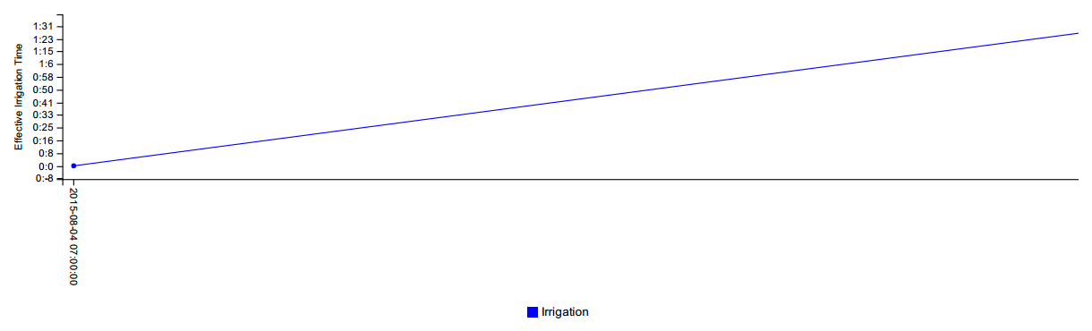
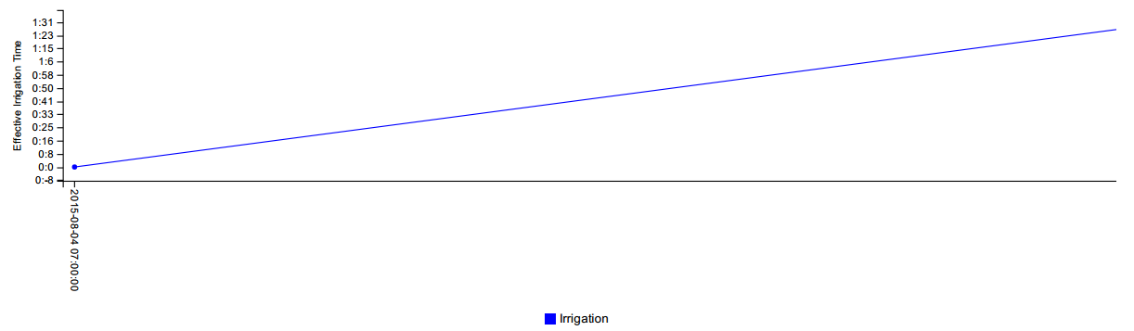
Plot 7, 9 Result Charts on Aug 4th 2015
Plot 7
Plot 9

Slide 121
Results Analysis on Aug 4th 2015
Results Analysis
Weather was too dry that some prototypes have not been trigged.
Plot 6 (Conductivity Prototype) allowed the longest time for absorption.

Slide 122
Quantitative Field Testing

Slide 123
Quantitative Field Testing Results
Irrigation Configurations for Sept 17th
Start Time | 8:00 AM
Effective Irrigation Time (EIT) | 30 minutes
Wait Time (WT) | 20 minutes
# of Tested Plot | 15 (Conductivity Prototype), 18 (Control)

Slide 124
Effective Irrigation Time Charts for Sept 17th
Plot 15 (Conductivity)
Plot 18 (Control)

Slide 125
Runoff Flow Rate Charts for Sept 17th
Plot 15 (Conductivity)
Plot 18 (Control)
Change to a Lower Scale

Slide 126
Summary of the Results for Sept 17th
 | Irrigation Time, IT (hr:min:sec) | Total Amount of Used Water (Gallon) | Runoff (Gallon) | Water Absorbed by Soil (Gallon) | Water Absorption Rate (Water Absorbed/Total Use) | % of Runoff Reduction
Plot 15 (Conductivity Prototype) | 5:26:32 | 217 | 27.07 | 189.93 | 87.5% | 49.3%
Plot 18 (Control) | 0:30:02 | 229 | 53.38 | 175.62 | 76.7% | N/A

Slide 127
Quantitative Field Testing Results
Irrigation Configurations for Sept 19th
Start Time | 7:55 AM (1st Test) 10:50 AM (2nd Test)
Effective Irrigation Time (EIT) | 15 minutes for each test
Wait Time (WT) | 10 minutes
# of Tested Plot | 15 (Conductivity Prototype), 18 (Control)

Slide 128
Effective Irrigation Time Charts for 1st Test on Sept 19th
Plot 15 (Conductivity)
Plot 18 (Control)

Slide 129
Effective Irrigation Time Charts for 2nd Test on Sept 19th
Plot 15 (Conductivity)
Plot 18 (Control)

Slide 130
Runoff Flow Rate Charts for Sept 19th
Plot 15 (Conductivity)
Plot 18 (Control)
Change to a Lower Scale

Slide 131
Summary of the Results for Sept 19th
 |  | Irrigation Time, IT (hr:min:sec) | Total Amount of Used Water (Gallon) | Runoff (Gallon) | Water Absorbed by Soil (Gallon) | Water Absorption Rate (Water Absorbed/Total Use) | % of Runoff Reduction
1st Test (EIT: 15 minutes) | Plot 15 (Conductivity) | 1:15:11 | 120 | 17.23 | 102.77 | 85.6% | 20.78%
 | Plot 18 (Control) | 0:15:01 | 115 | 21.75 | 93.25 | 81.1% | N/A
2nd Test (EIT: 15 minutes) | Plot 15 (Conductivity) | 5:15:44 | 122 | 33 | 89 | 73.0% | 46.48%
 | Plot 18 (Control) | 0:15:01 | 116 | 61.66 | 54.34 | 46.8% | N/A

Slide 132
Summary of the Results for Sept 19th (Con)
 |  | Irrigation Time, IT (hr:min:sec) | Total Amount of Used Water (Gallon) | Runoff (Gallon) | Water Absorbed by Soil (Gallon) | Water Absorption Rate (Water Absorbed/Total Use) | % of Runoff Reduction
Total (EIT: 30 minutes) | Plot 15 (Conductivity) | 6:30:12 | 242 | 50.23 | 191.77 | 79.2% | 39.78%
 | Plot 18 (Control) | 0:30:02 | 231 | 83.41 | 147.59 | 63.9% | N/A

